Slide 1

WALMART DATA ANALYSIS
-PRADYUMNA P

Slide 2
OBJECTIVE:
The major aim of this project is to gain insight into the sales data of Walmart to understand the different factors that affect sales of the different branches.
ABOUT DATASET:
Data set was sourced from Kaggle-Walmart Sales Forecasting Competition. It consists of one CSV file with 600+ records.
Comprised of variables like Invoice ID, Branch, City, Customer, Type, Gender, Product line, Unit price, Quantity, VAT, Total, Date, Time, Payment, cogs, Gross Margin, Percentage, Gross Income, Rating.
TOOL USED FOR ANALYSIS:
SQL (My SQL Workbench 8.0 CE)
KEY HIGHLIGHTS:
Analysis on the data understands the different product lines, the products lines performing best and the product lines that need to be improved.
This analysis aims to answer the question of the sales trends of product. The result of this can help use measure the effectiveness of each sales strategy the business applies and what modificatoins are needed to gain more sales.
This analysis aims to uncover the different customers segments, purchase trends and the profitability of each customer segment.

Slide 3
SQL QUERIES

Slide 4
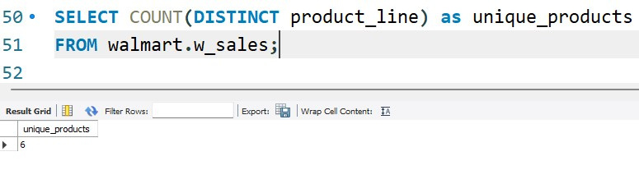
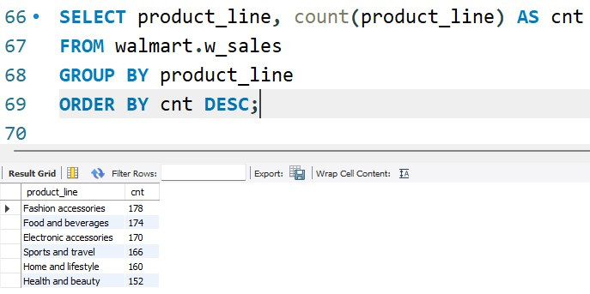
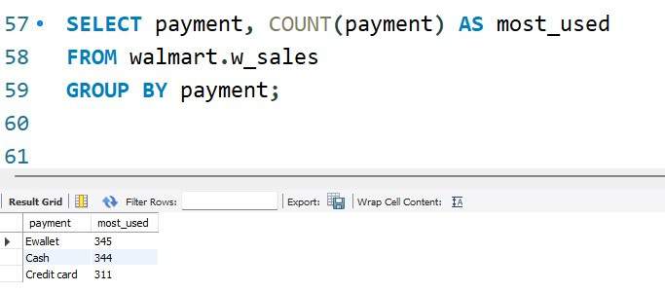
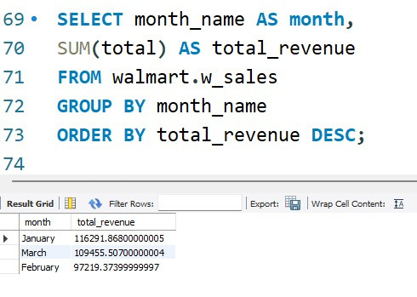
Product Analysis
Q1: How many unique product lines does the data have?
Q3:What is the most selling product line?
Q2:What is the most common payment method?
Q4:What is the total revenue by month?

Slide 5
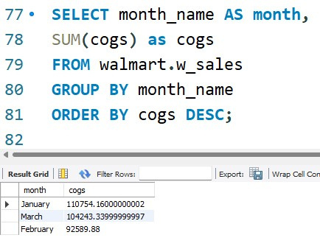
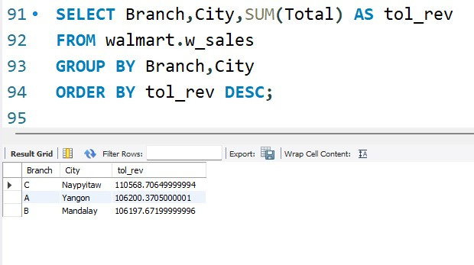
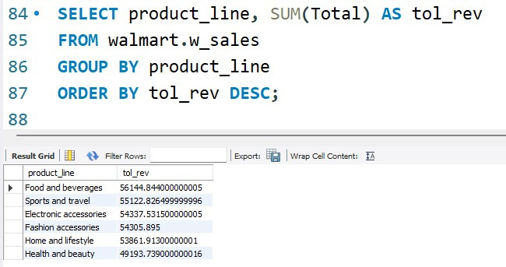
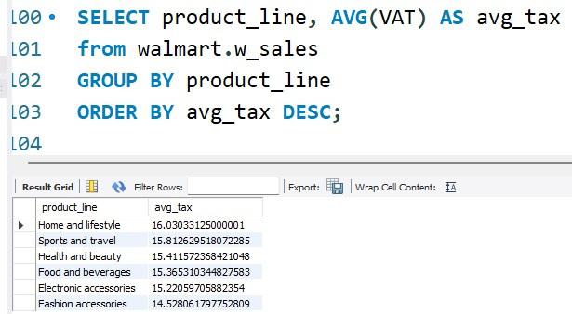
Q5:What month had the largest COGS?
Q7:What is the city with the largest revenue?
Q6:What product line had the largest revenue?
Q8:What product line had the largest VAT?

Slide 6
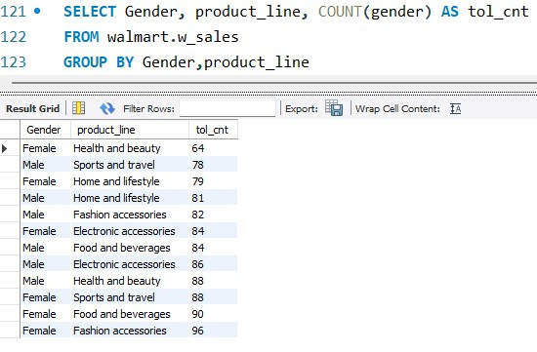
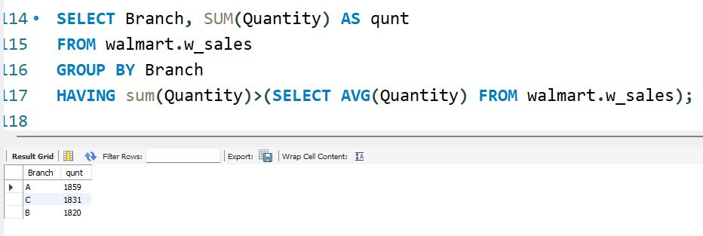
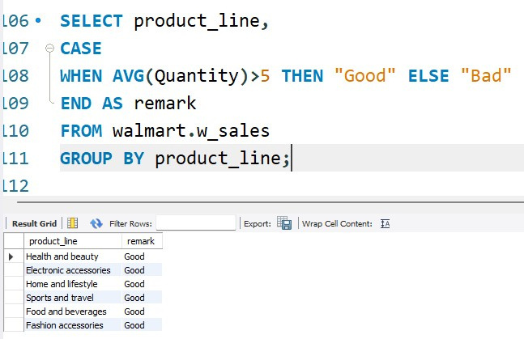
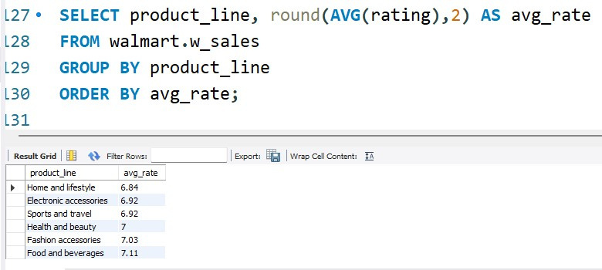
Q9:Which branch sold more products than average product sold?
Q11:What is the most common product line by gender?
Q10:Fetch each product line and add a column to those product line showing "Good", "Bad". Good if its greater than average sales
Q12:What is the average rating of each product line?

Slide 7
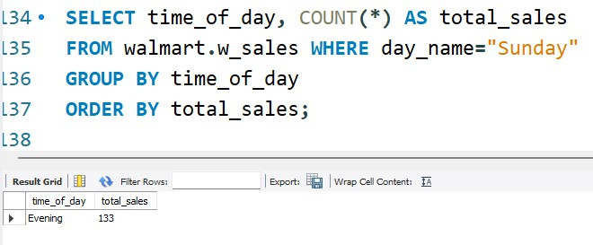
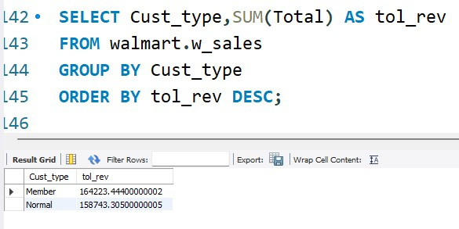
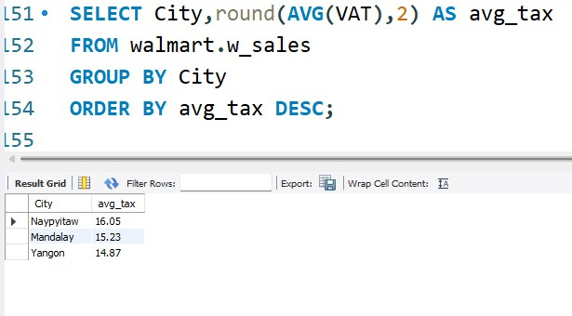
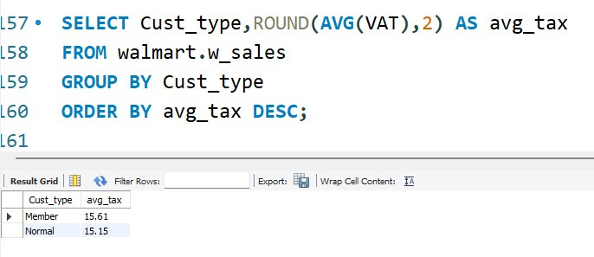
Sales Analysis
Q1:Number of sales made in each time of the day per weekday
Q2:Which of the customer types brings the most revenue?
Q3:Which city has the largest tax percent/ VAT (Value Added Tax)?
Q4:Which customer type pays the most in VAT?

Slide 8
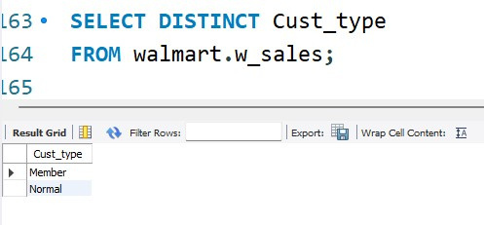
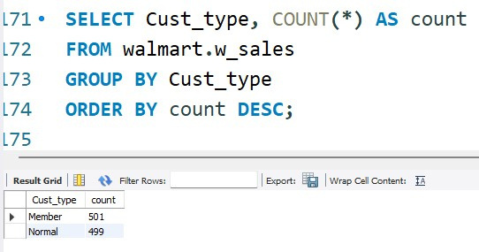
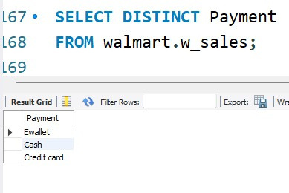
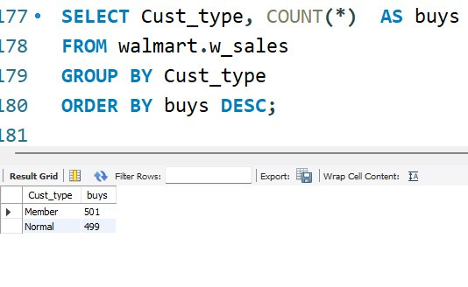
Customer Analysis
Q1:How many unique customer types does the data have?
Q3:What is the most common customer type?
Q2:How many unique payment methods does the data have?
Q4:Which customer type buys the most?

Slide 9
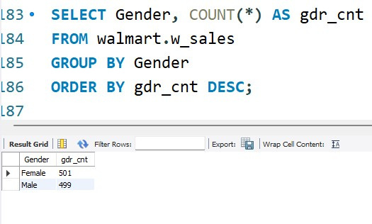
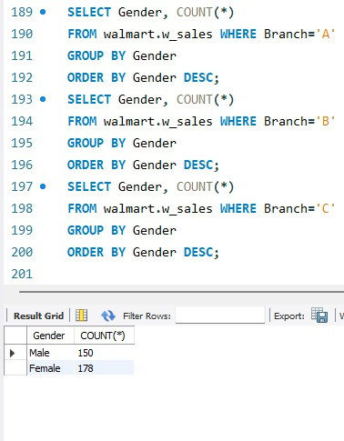
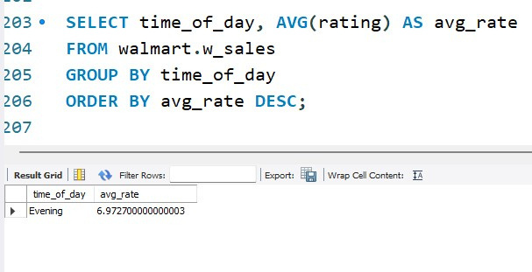
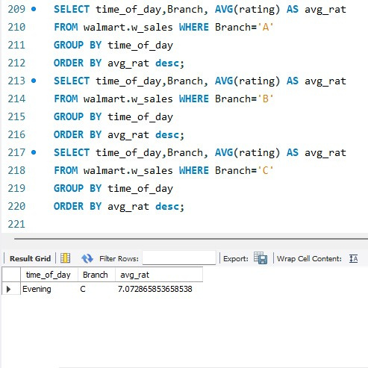
Q5:What is the gender of most of the customers?
Q6:What is the gender distribution per branch?
Q7:Which time of the day do customers give most ratings?
Q8:Which time of the day do customers give most ratings per branch?

Slide 10
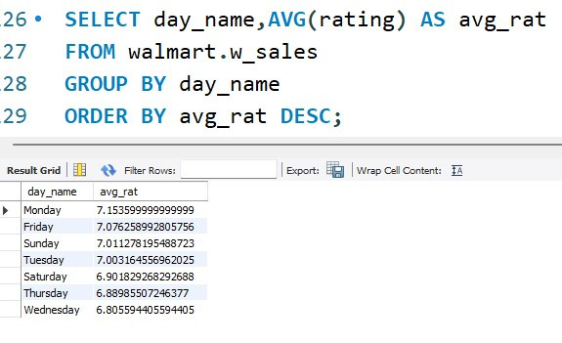
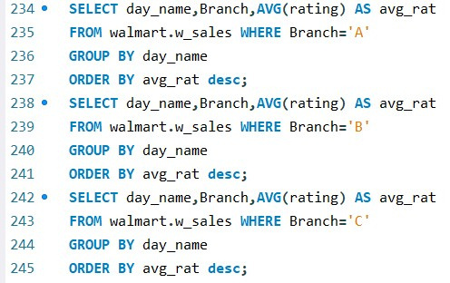
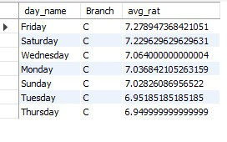
Q9:Which day of the week has the best avg ratings?
Q10:Which day of the week has the best average ratings per branch?

